Slide 1


NATIONAL SERVICE SCHEME
JANKI DEVI MEMORIAL COLLEGE
DELHI UNIVERSITY
01
Neev Project

Slide 2
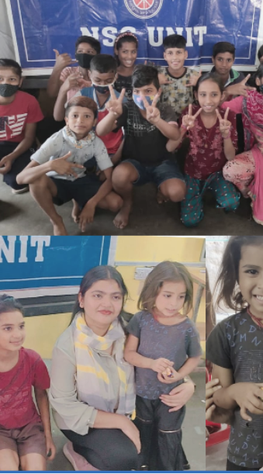
Key Points
  Offline Teaching
  Extracurricular
  Activities
  Carrier Guidence
  Hygiene Importance
  Social Awareness
HIGHLIGHTS AND INSIGHTS
02

Slide 3
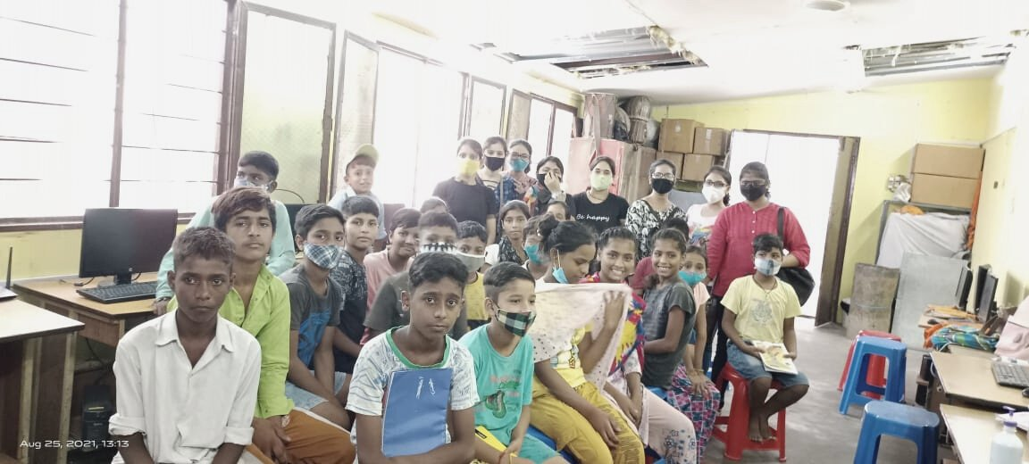
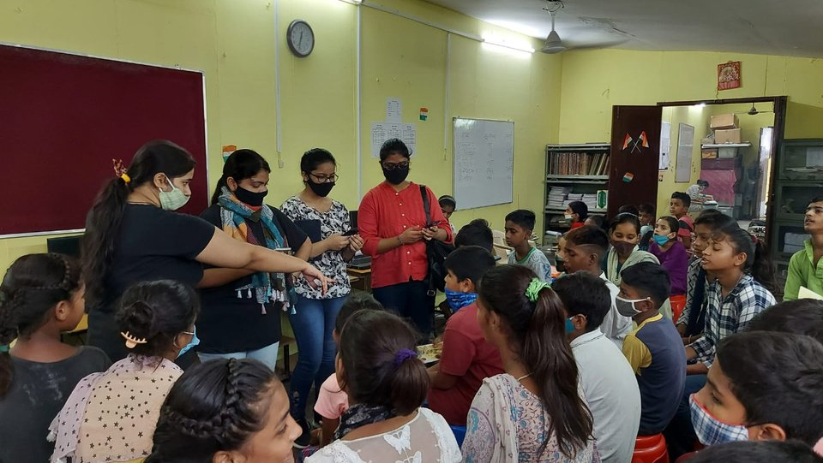
Introduction
A Slum situated at Anand Parbat, Shadipur is home to about
three thousand families comprising a community of
puppeteers, singers, magicians, musicians, dancers and a
variety of other performers who were living in Kathputali
Colony in Shadipur Depot since 1950 and are now waiting
for their homes to be reconstructed at Kathputali Colony.
In 2010, Government of Delhi initiated the redevelopment
project of the Kathputali colony on a public - private
partnership basis. The contract was granted to Raheja
Developers. As per the plan, 2800 flats will be built in 10
story buildings on 5.2 hectares.
03

Slide 4
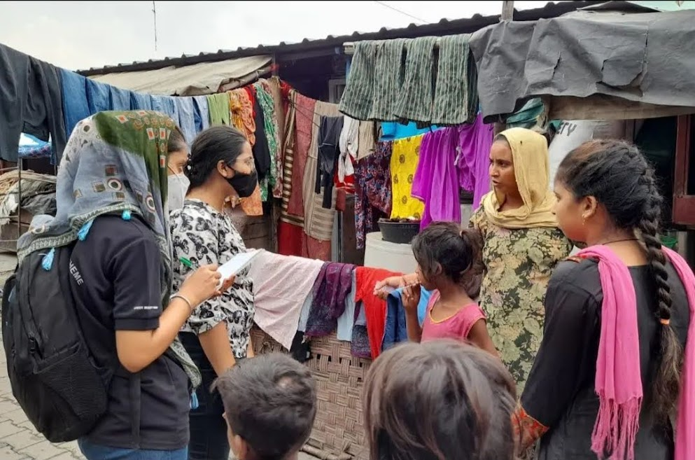
Offline Education
THE NATIONAL SERVICE SCHEME, JANKI DEVI MEMORIAL COLLEGE AIMS AT PROVIDING FREE EDUCATION TO THE CHILDREN LIVING IN OUR ADOPTED SLUM SITUATED AT ANAND PARBAT, SHADIPUR IN COLLABORATION WITH KALAKAR TRUST.
Keeping this in mind our volunteers, under the Project NEEV started by NSS JDMC , are providing free education to the slum children for 2 hours, 6 days per week which includes Maths, Science, Social Studies, Spoken English, hindi and also awareness on current topics.We don’t teach them on sundays.
04

Slide 5
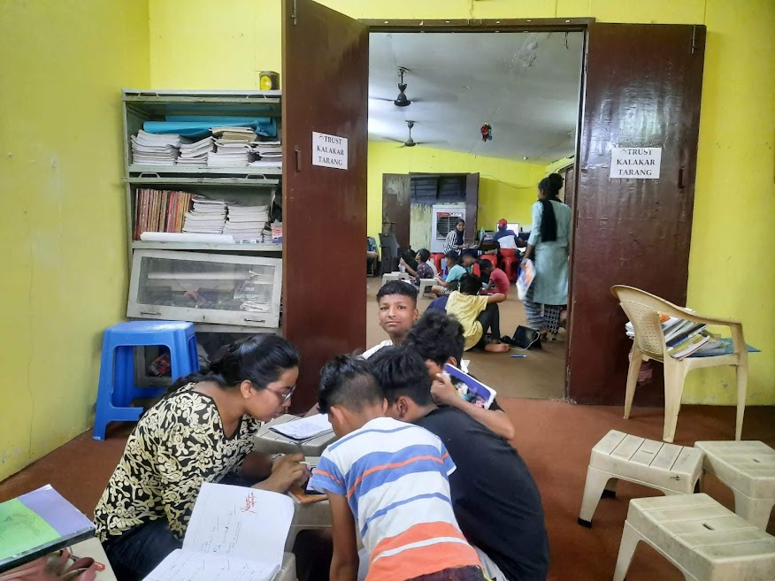
  We provide them with education and social awareness regarding different topics like covid - 19, social distancing, menstruation, health and hygiene, etc.
  Improve vocabulary of students in Hindi and English.
05

Slide 6
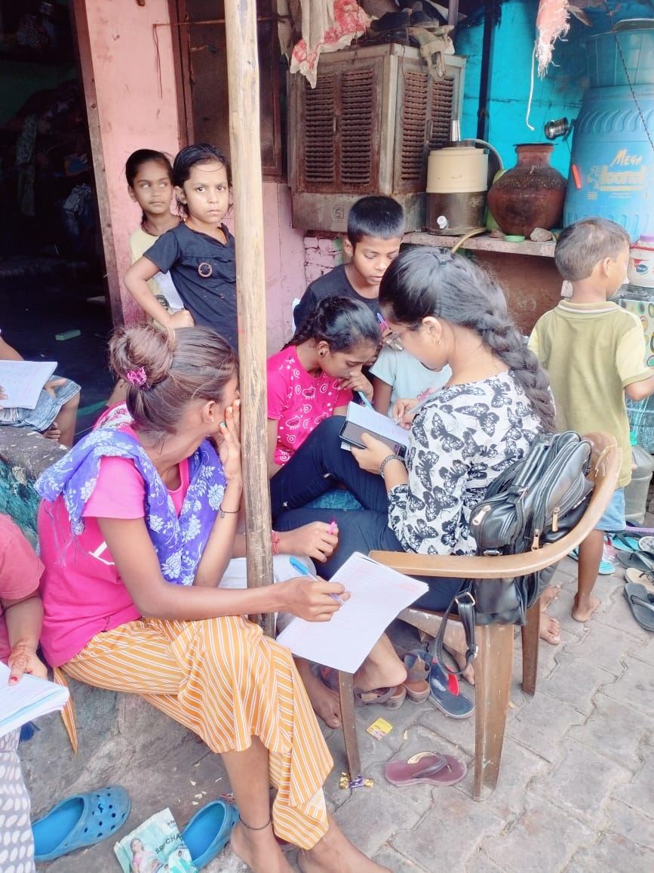
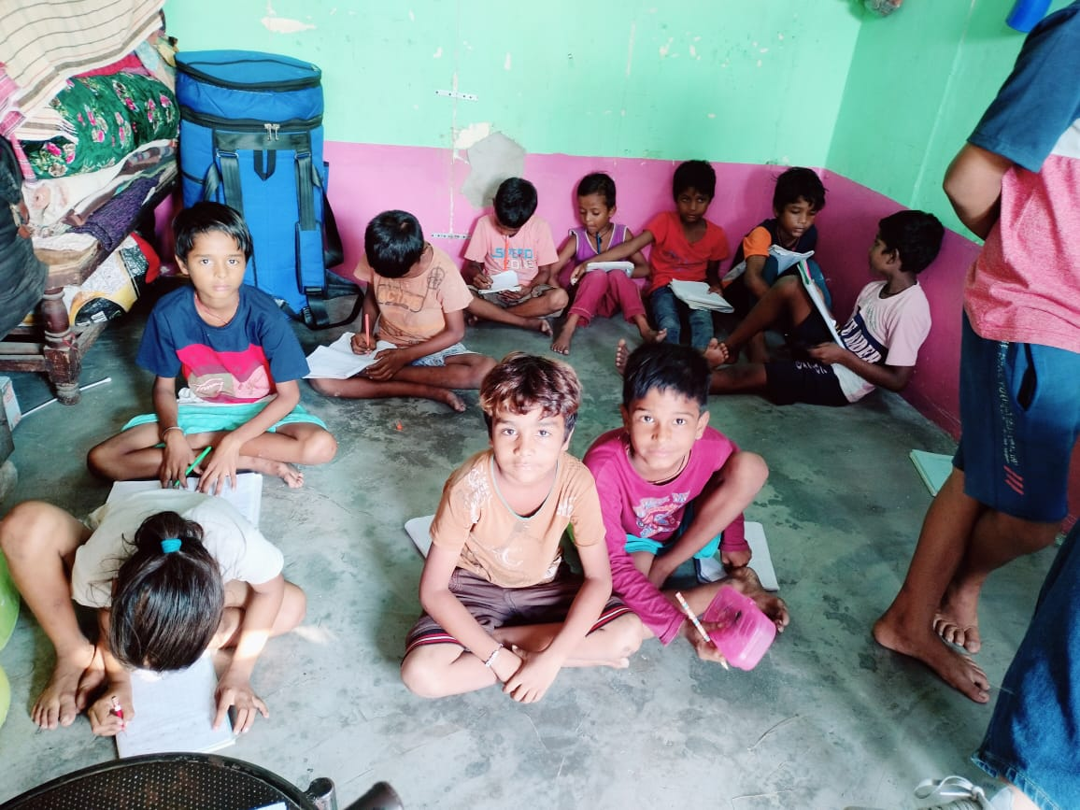
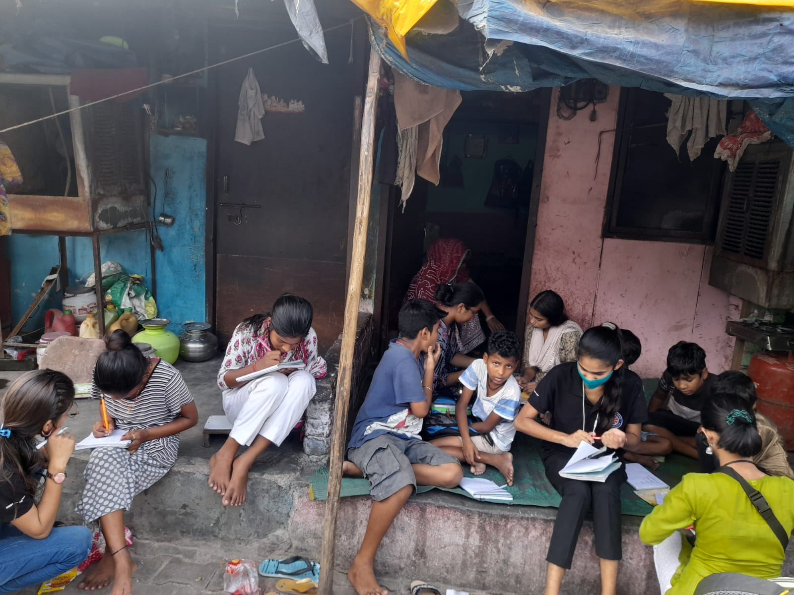
Glimpses of our work
06

Slide 7
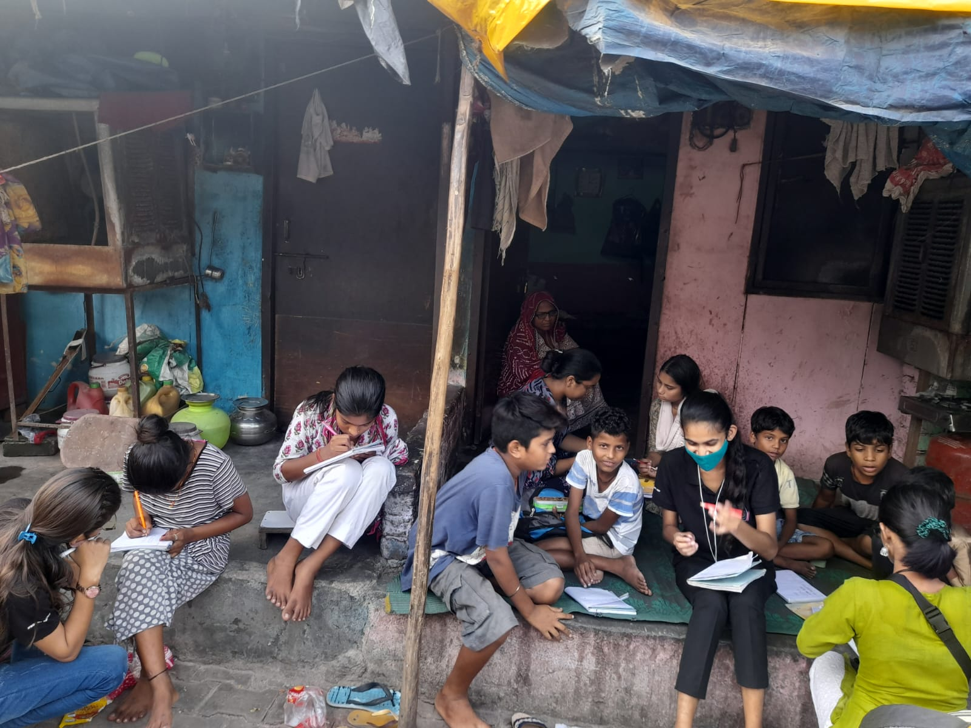
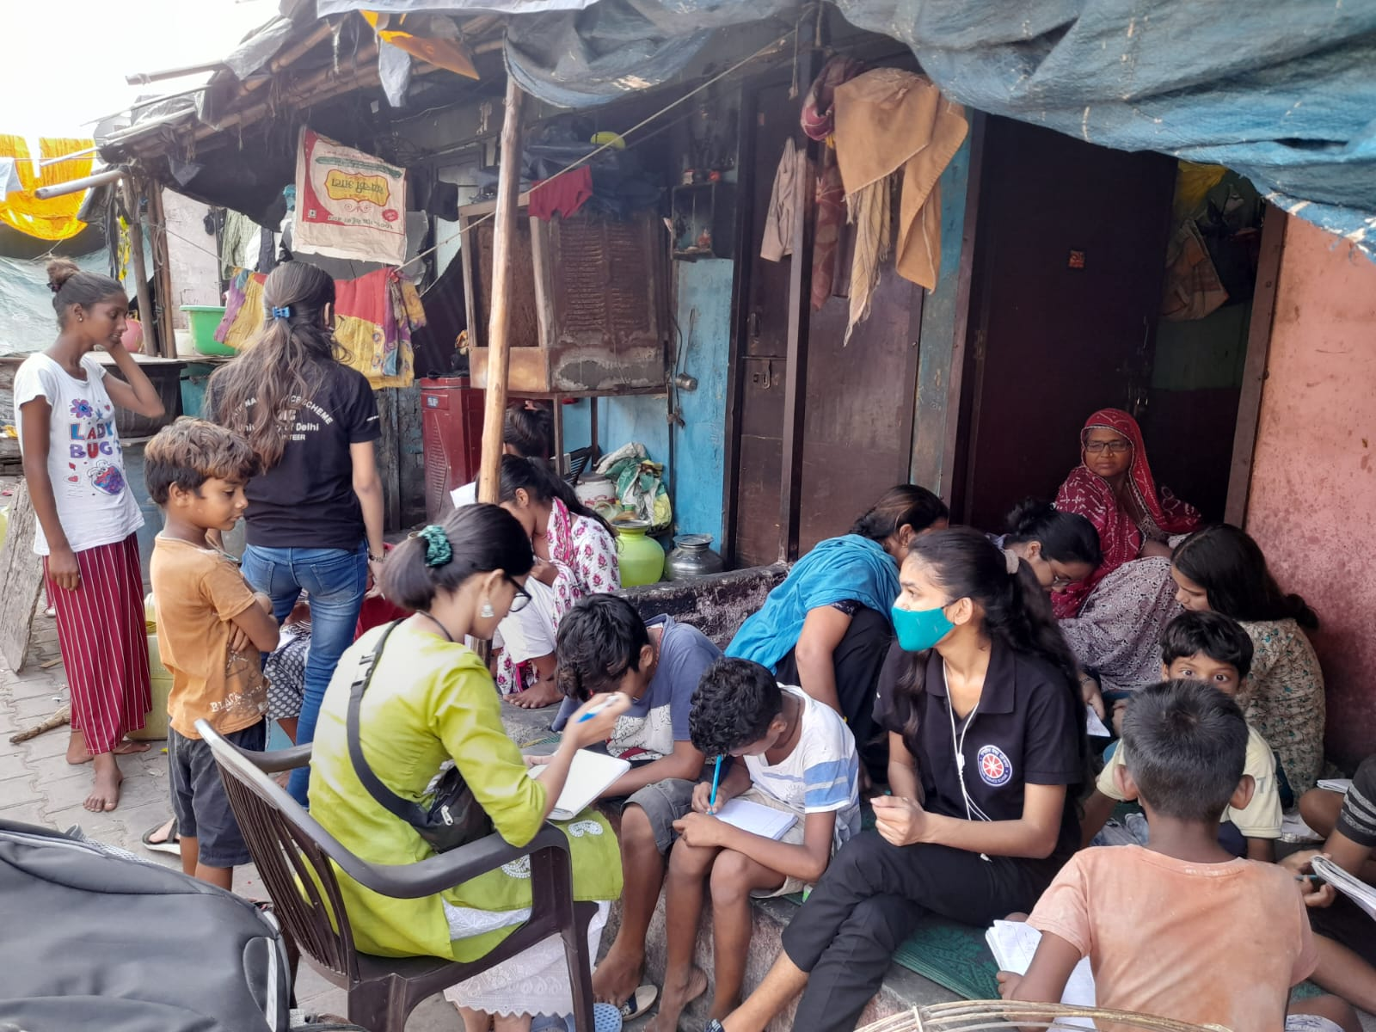
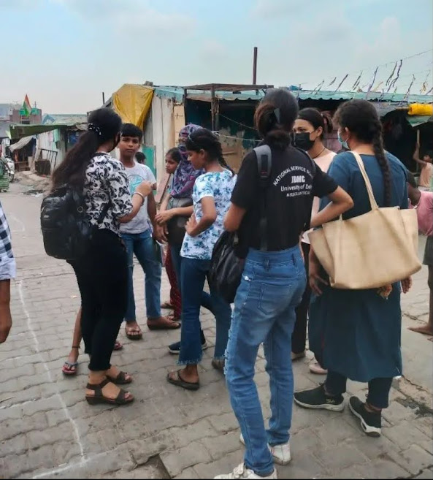
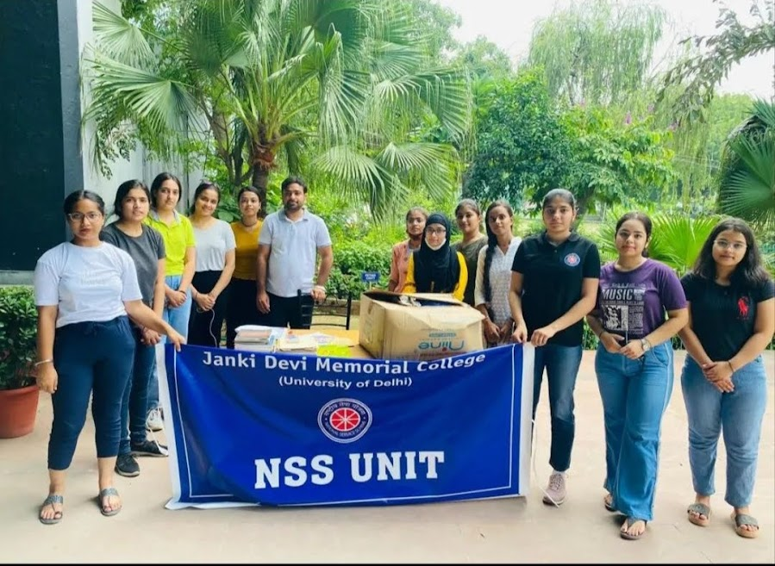
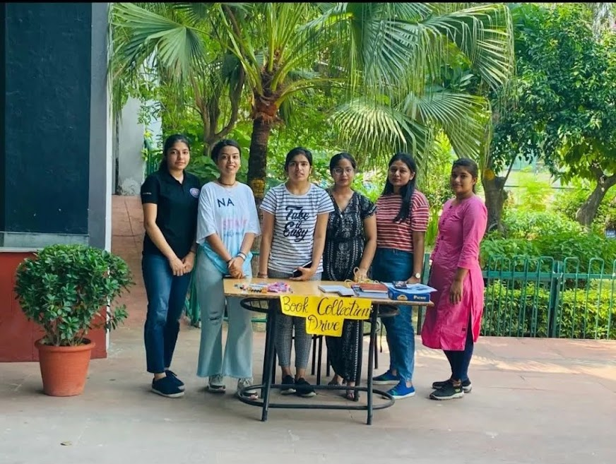
07

Slide 8
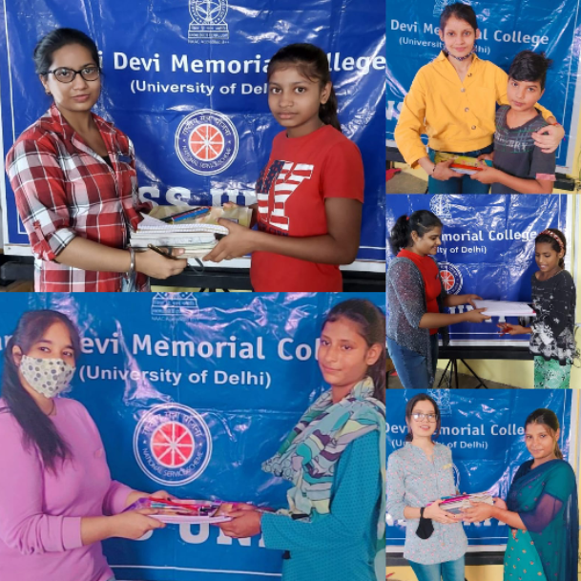
Donation Drives
Apart from the online teaching, we also visit the slum to know their needs and to make donations like Food Donation, cloth Donation, book donation, etc. On 18th October, we organized a “Books and Stationary Donation Drive'' keeping in mind the needs of the children.
GIVING IS NOT JUST ABOUT DONATIONS BUT IT IS ABOUT CREATING A DIFFERENCE
08

Slide 9
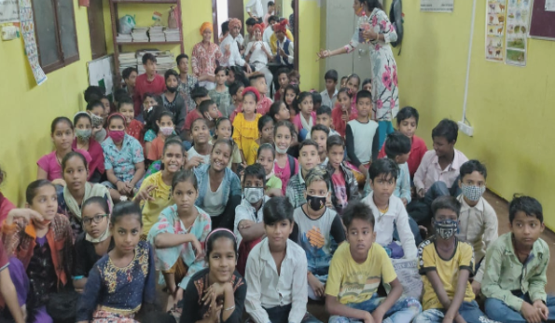
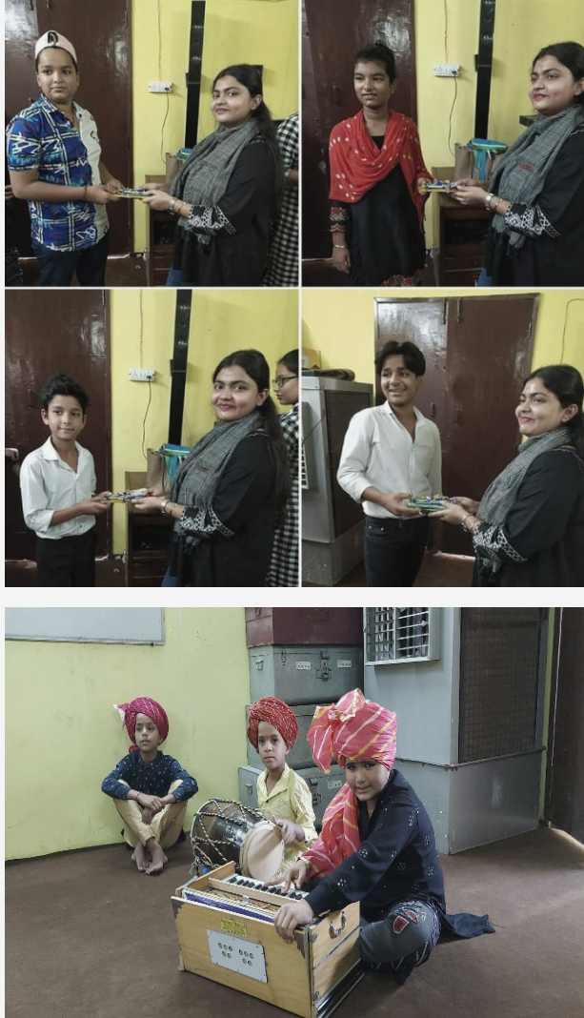
Organizing competitions
WE ORGANISE DIFFERENT COMPITITIONS ON VARIOUS OCCASIONS LIKE RECENTLY ON THE OCCASION OF DEEPAWALI TO BRING JOY AND HAPPINESS ON THE FACES OF THE CHILDREN, NSS(JDMC) ORGANISED A DANCING AND SINGING COMPETITION.
09

Slide 10
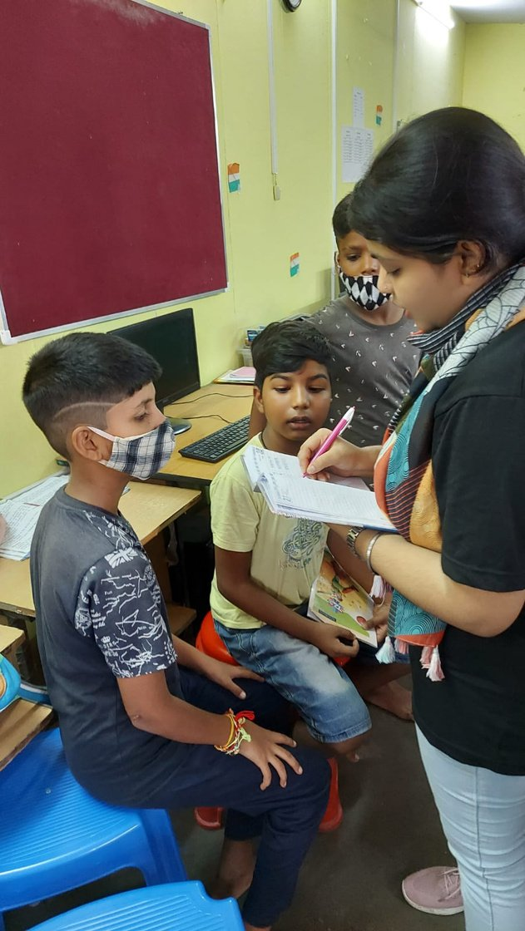
10

Slide 11
Thank you
It is not enough to be
11

